Slide 1
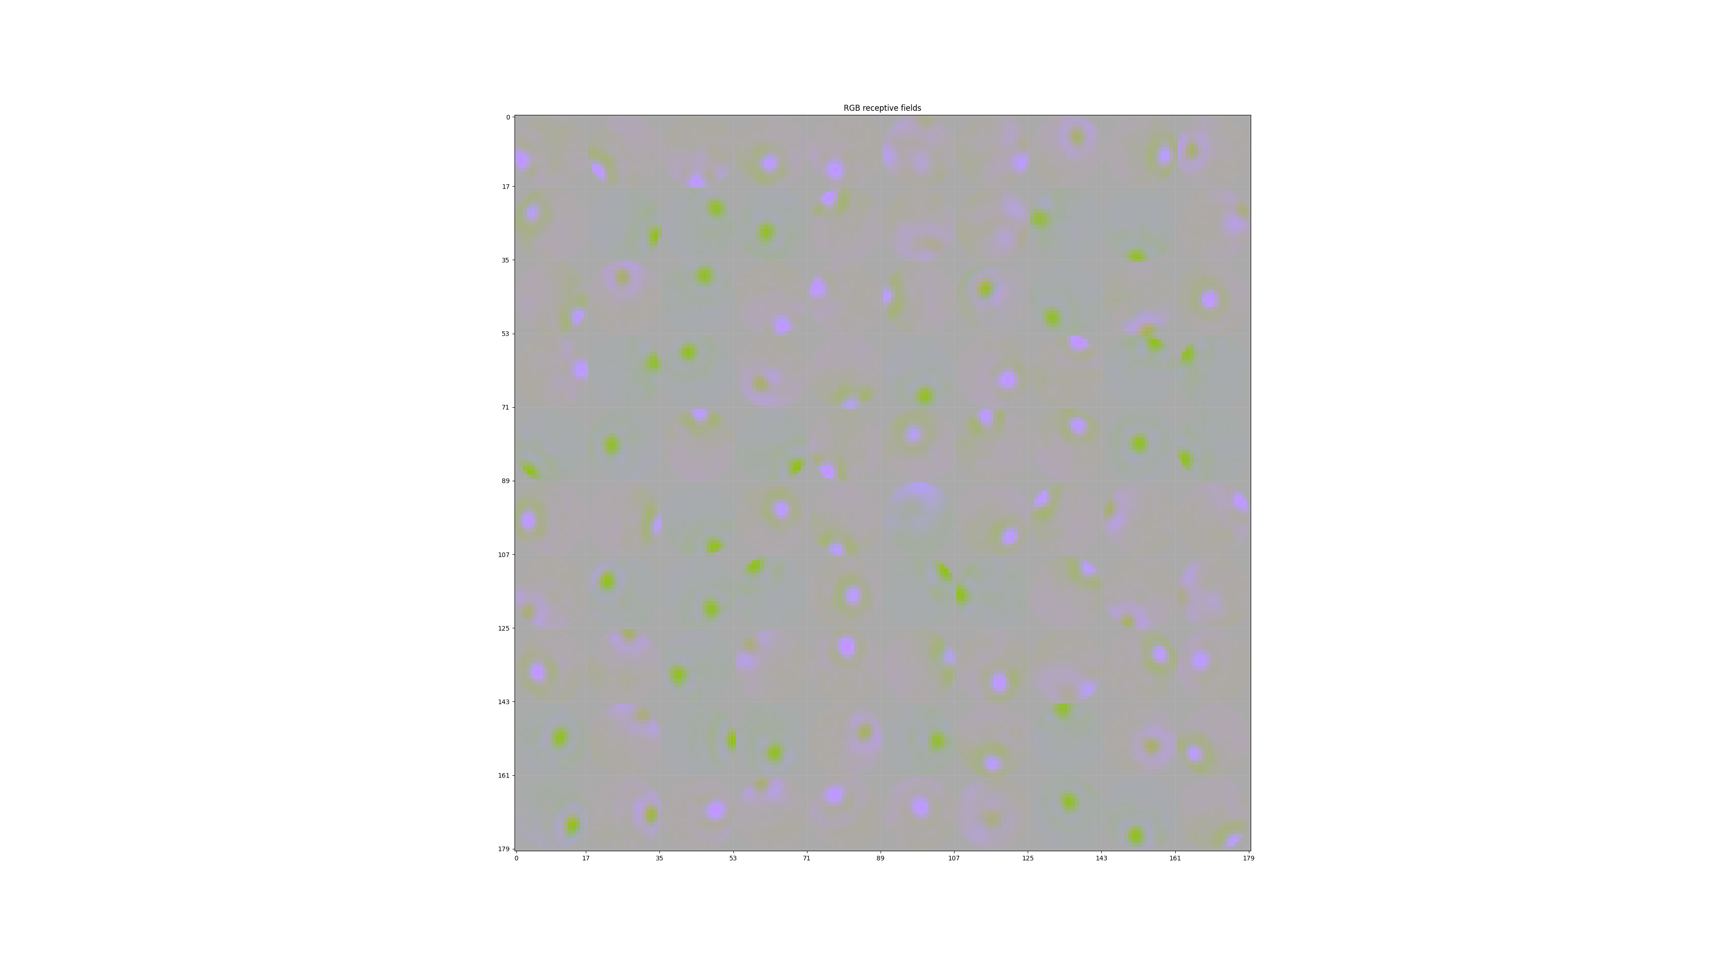
Note: L2 has been normalized to be a constant for each kernel

Slide 2
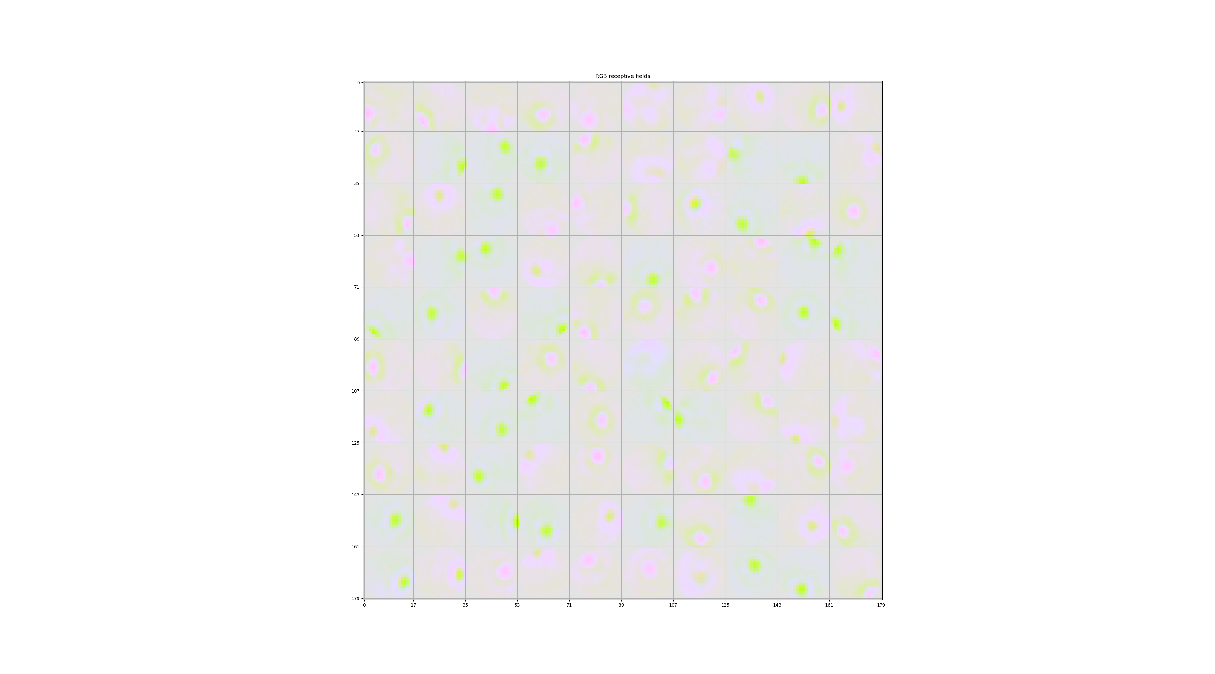
If I increase the contrast a little bit: Saturation, but the image looks better

Slide 3
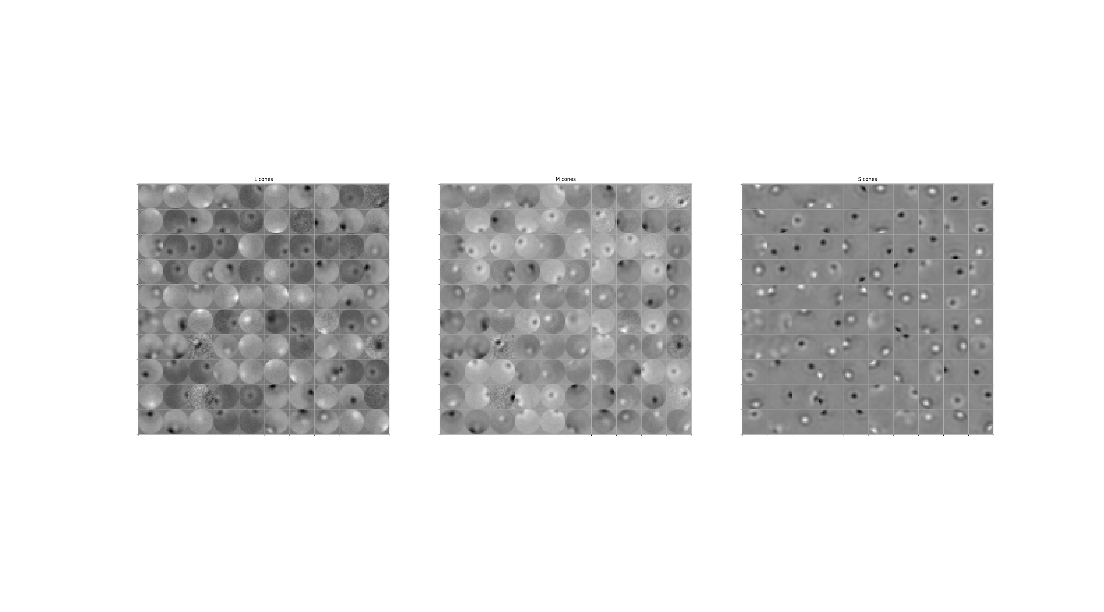
Receptive fields for each cone type
L cones M cones S cones

Slide 4

PCA loadings
L M S
= Luminance channel (53% variance)
= (L+M) - S channel (blue/yellow; 4.9% variance)
= L - M channel (red/green; 0.38% variance)

Slide 5
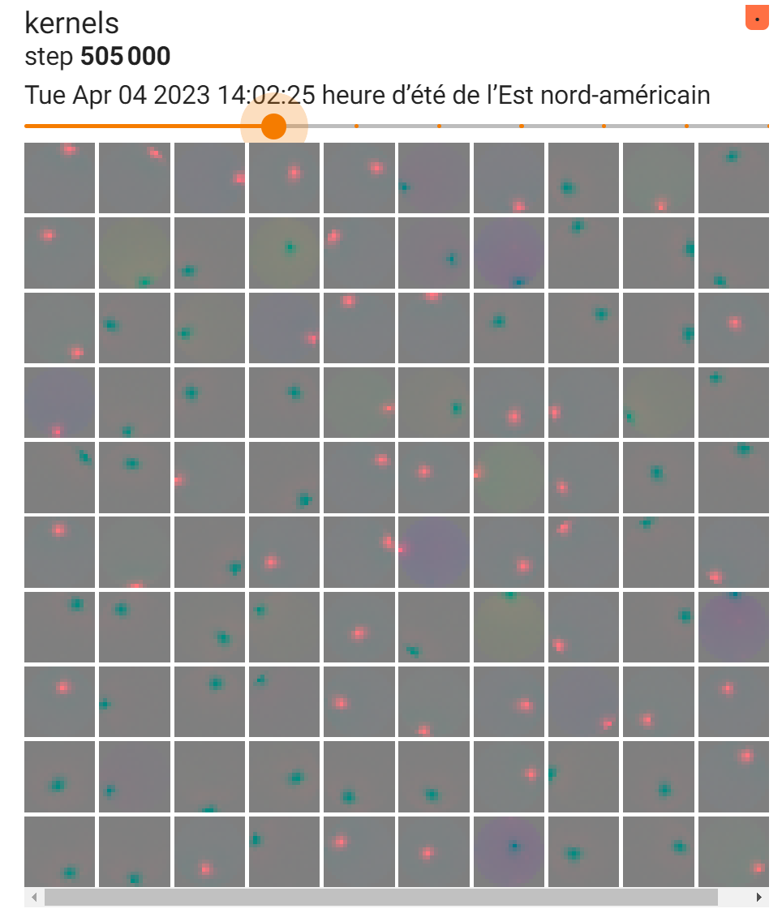
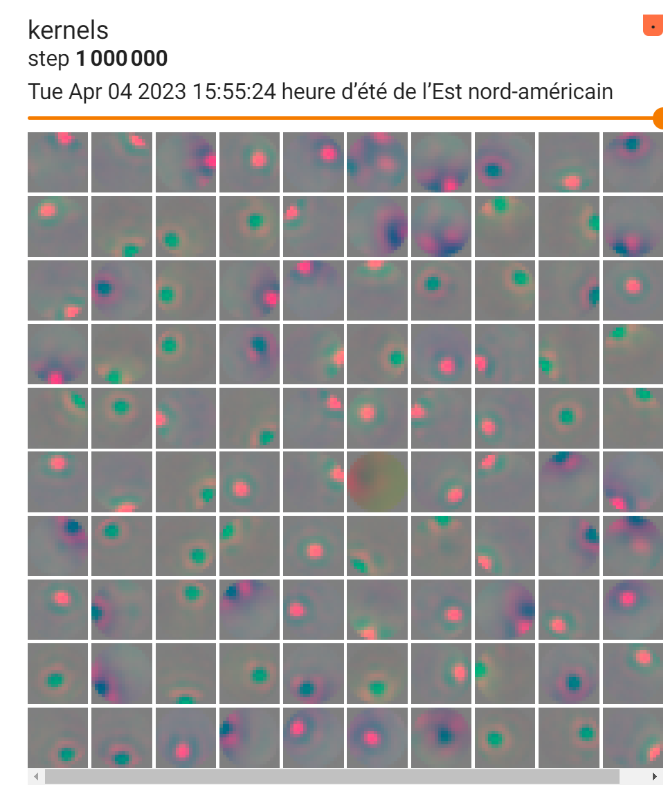
Around step 500k, RGCs developed a surround
Note: This is in PCA space (red = luminance, green = blue/yellow channel)

Slide 6
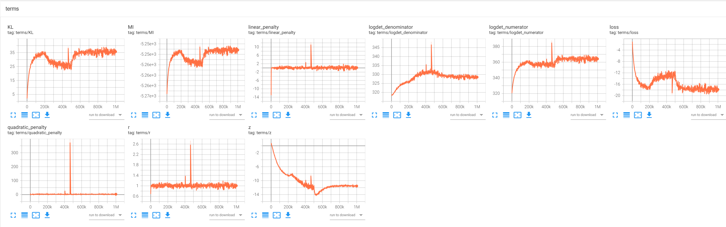
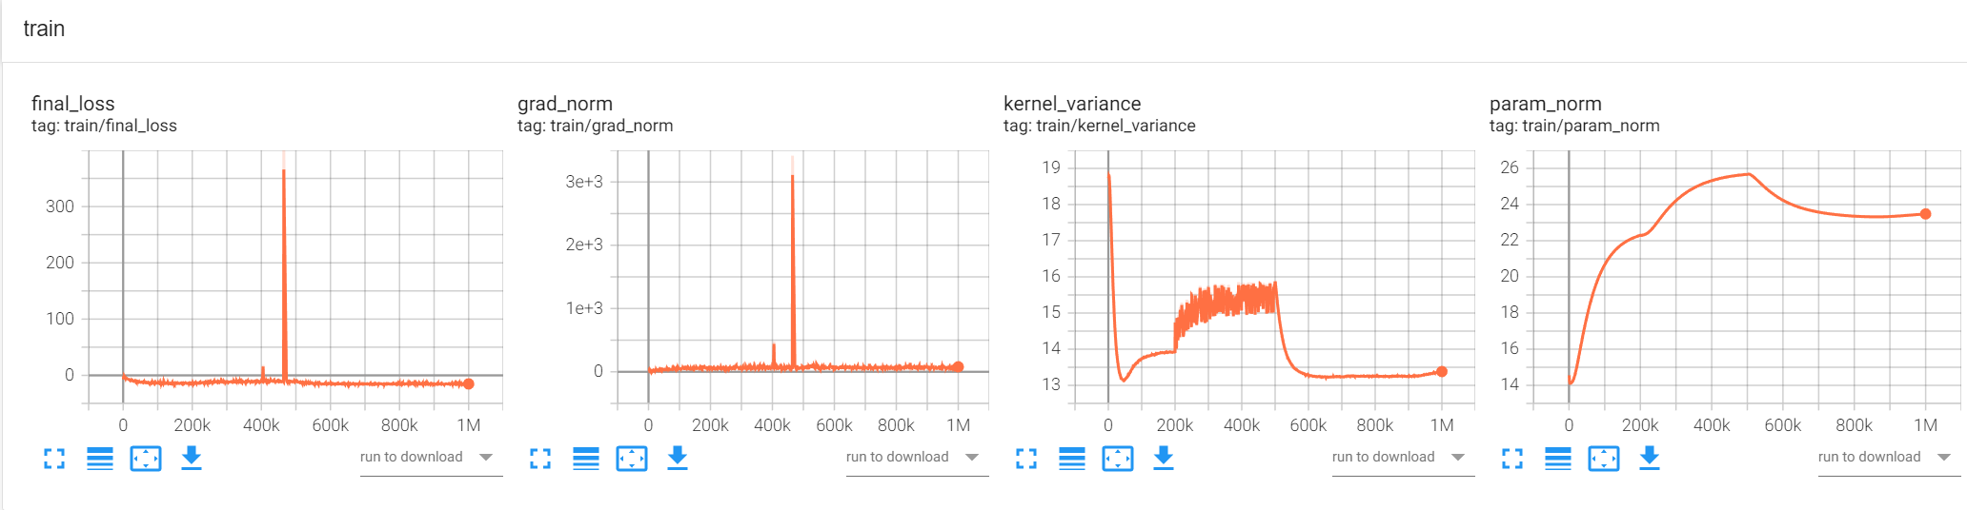

Slide 7
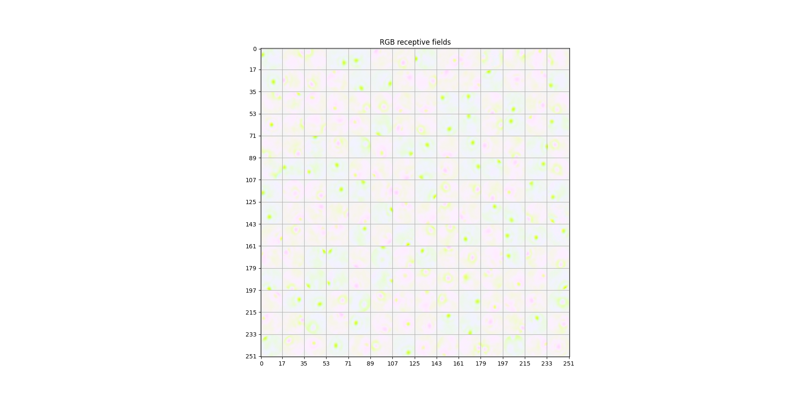
What if we increase the number of RGCs to 200?

Slide 8
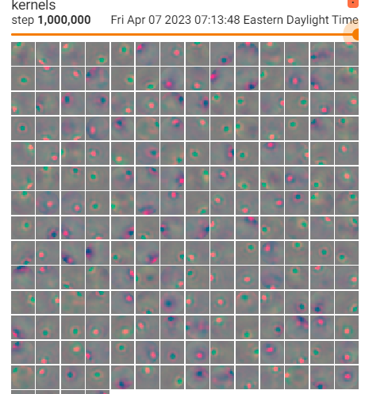
PCA space – surrounds are more clear
Note: This is in PCA space (red = luminance, green = blue/yellow channel)

Slide 9
